Slide 1
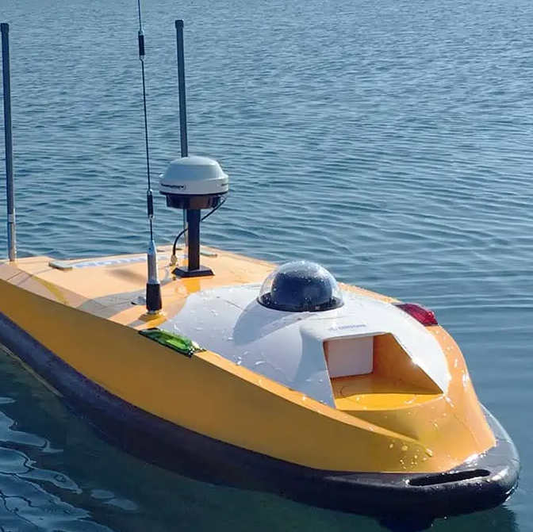
Robot design challenge 4: Small boat with manipulator for picking plastic
Bendik, Lars, Lars & Sebastian

Slide 2
ROS2/Gazebo simulation

Slide 3
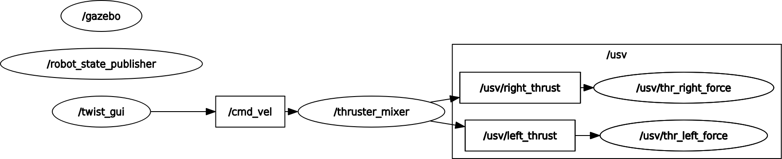
ROS2/Gazebo simulation
Brukt Github for iterasjon
Buoyancy gazebo og ROS-Force plugin
Fusion modell for USVen
Simpel python TKinter gui

Slide 4
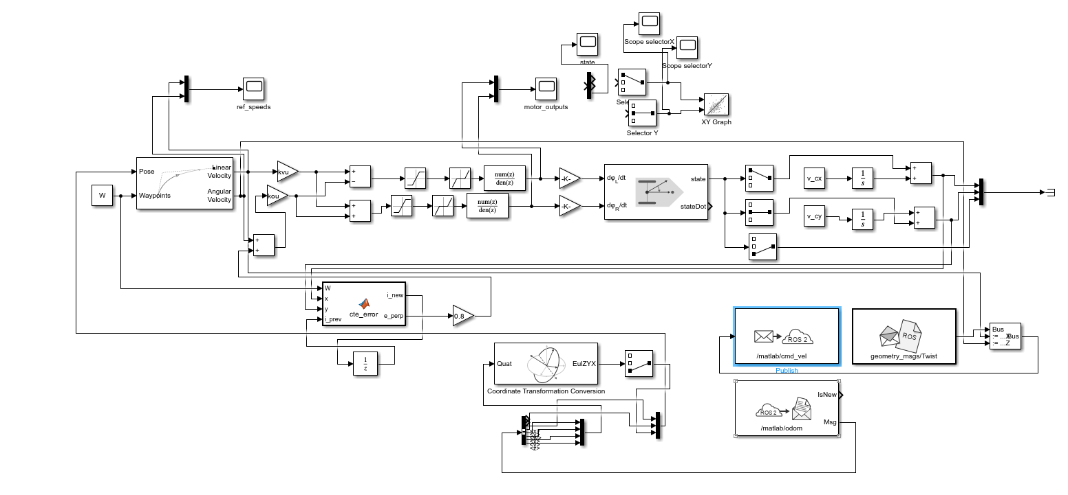
ROS2/Gazebo simulation

Slide 5
ROS2/Gazebo simulation next steps

Slide 6
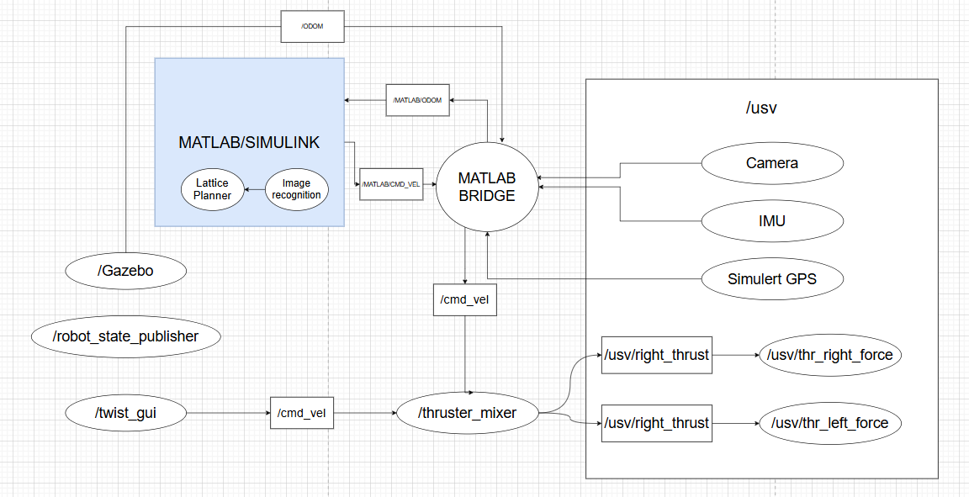
ROS2/Gazebo simulation next steps

Slide 7
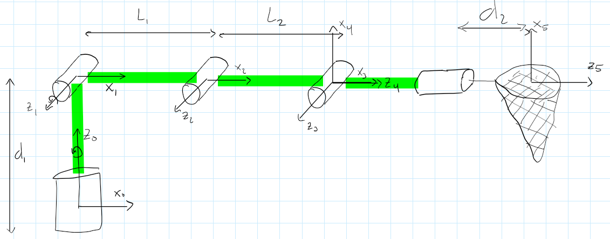
Arm

Slide 8
DH-tabell, 5DOF arm
Link | θ | d | a | α
1 | θ1 | d1 | 0 | π/2
2 | θ2 | 0 | L1 | 0
3 | θ3 | 0 | L2 | 0
4 | θ4 + π/2 | 0 | 0 | π/2
5 | θ5 | d2 | 0 | 0

Slide 9
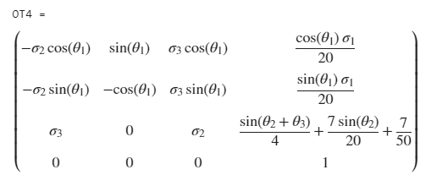
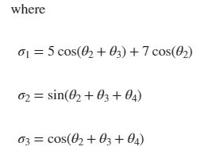
Transformasjonsmatrise
0T4 = 0T1*1T2*2T3*3T4

Slide 10
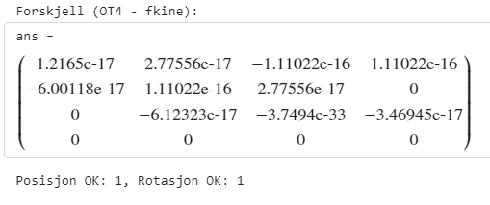
Utregnet forward kinematics vs toolbox

Slide 11
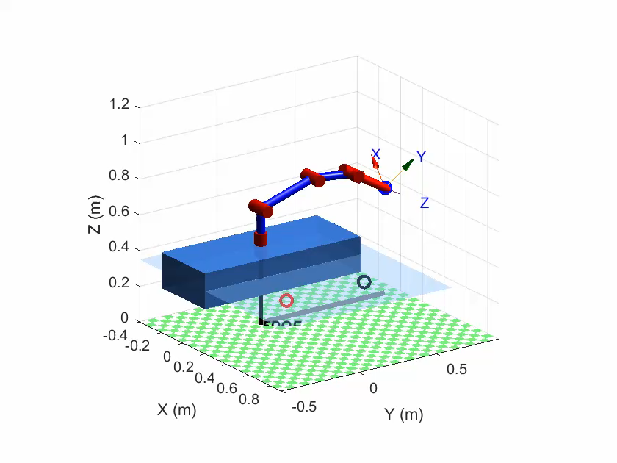

Slide 12
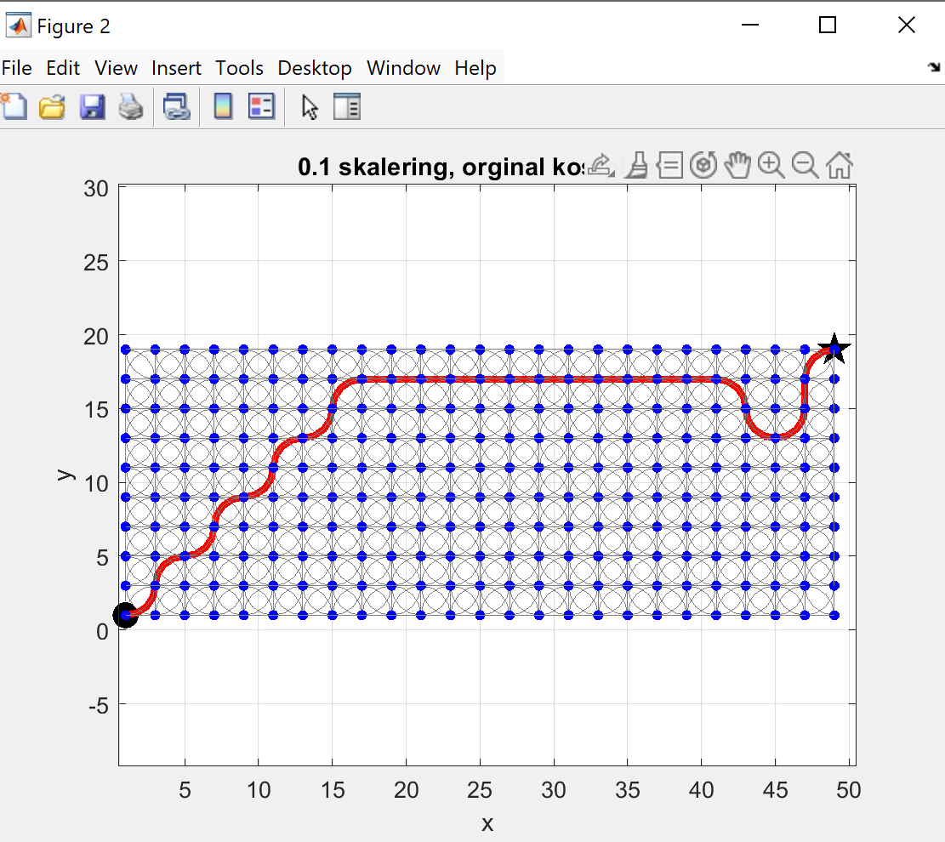
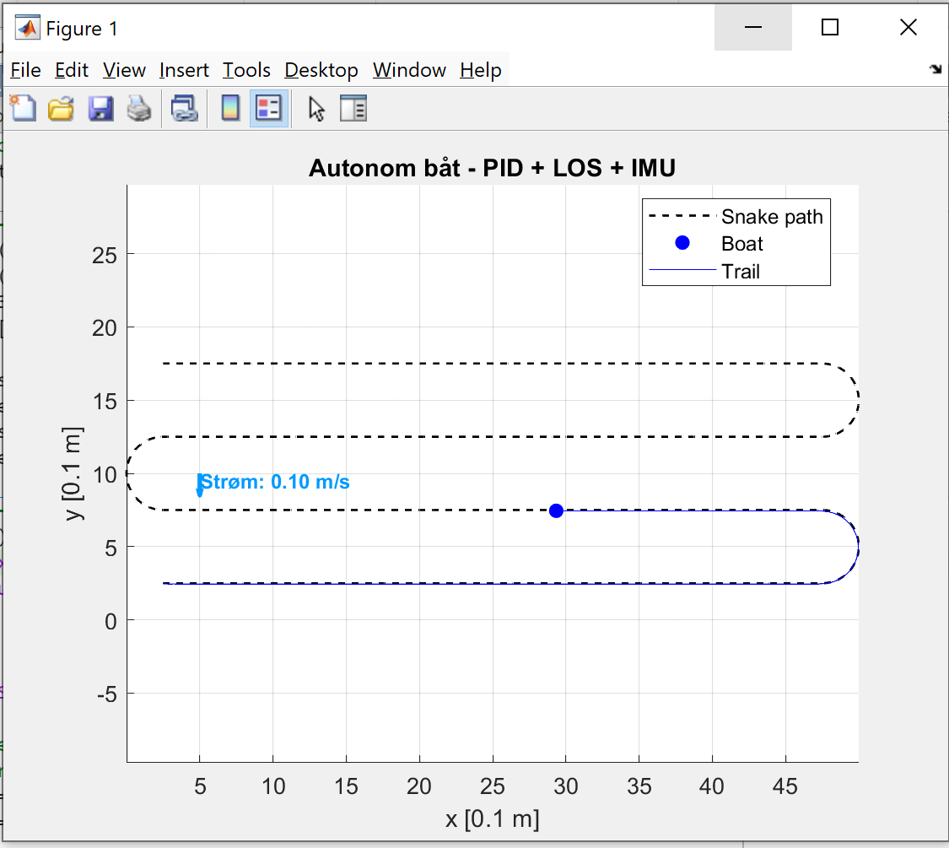
Matlab Simulering
Simulering med .m filformat
Simulering med Simulink

Slide 13
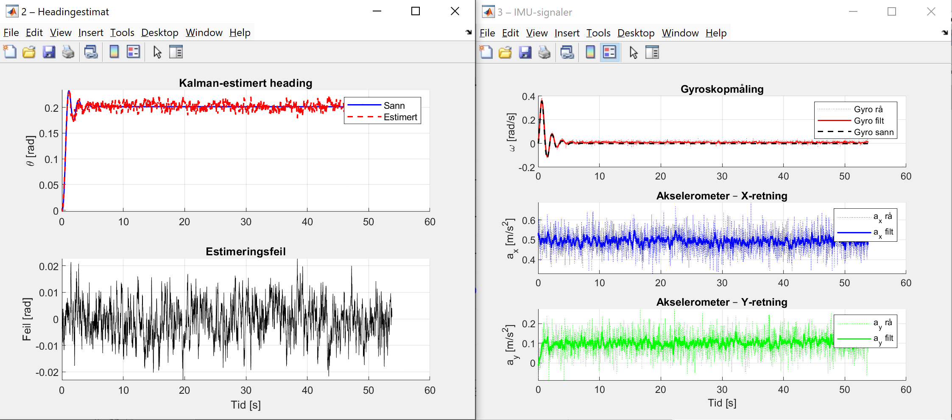
Matlab Simulering

Slide 14
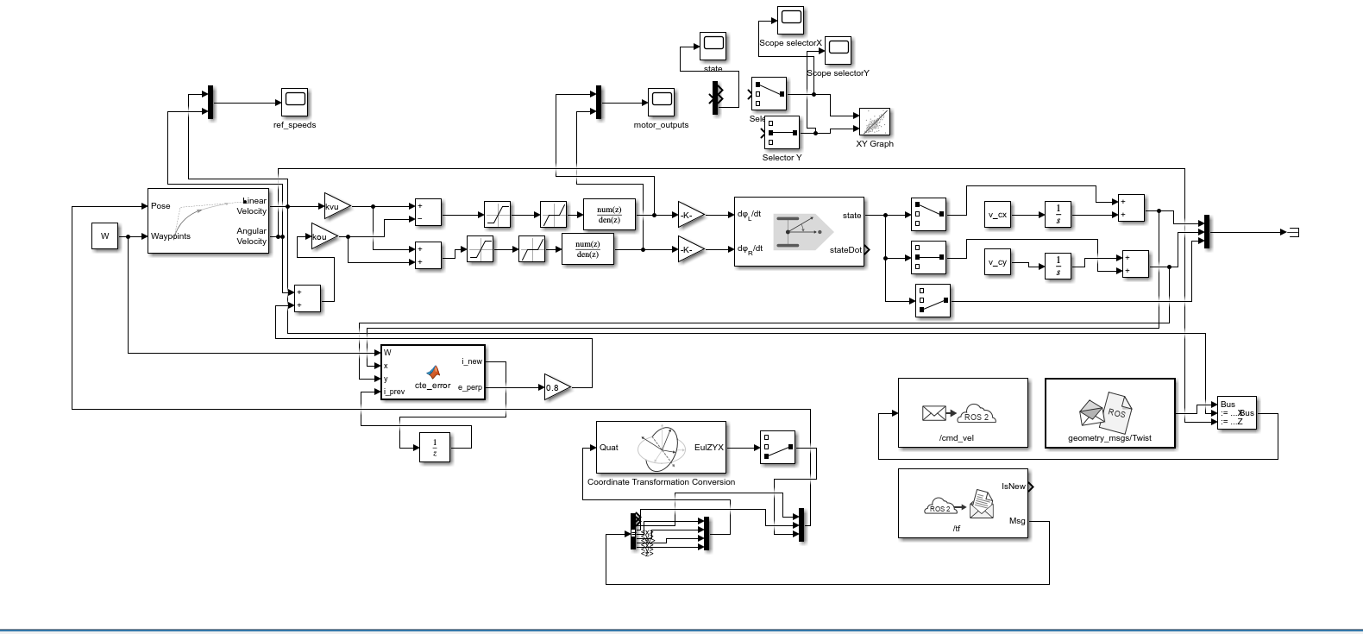
Matlab Simulering​

Slide 15
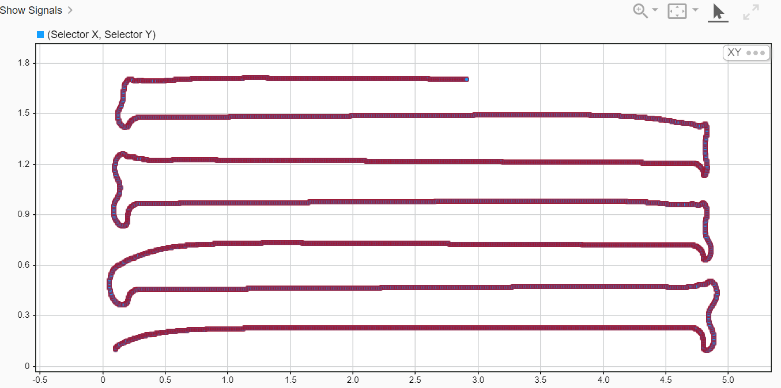
Matlab Simulering​

